Slide 1

Personal Protective Equipment Detection
An overview of challenges and solutions for PPE detection using computer vision.
Muneeb ur Rehman Khan (2024-MSDS-115)
Rehman Kabir (2024-MSDS-120)
Shamroz Ali (2024-MSDS-122)

Slide 2
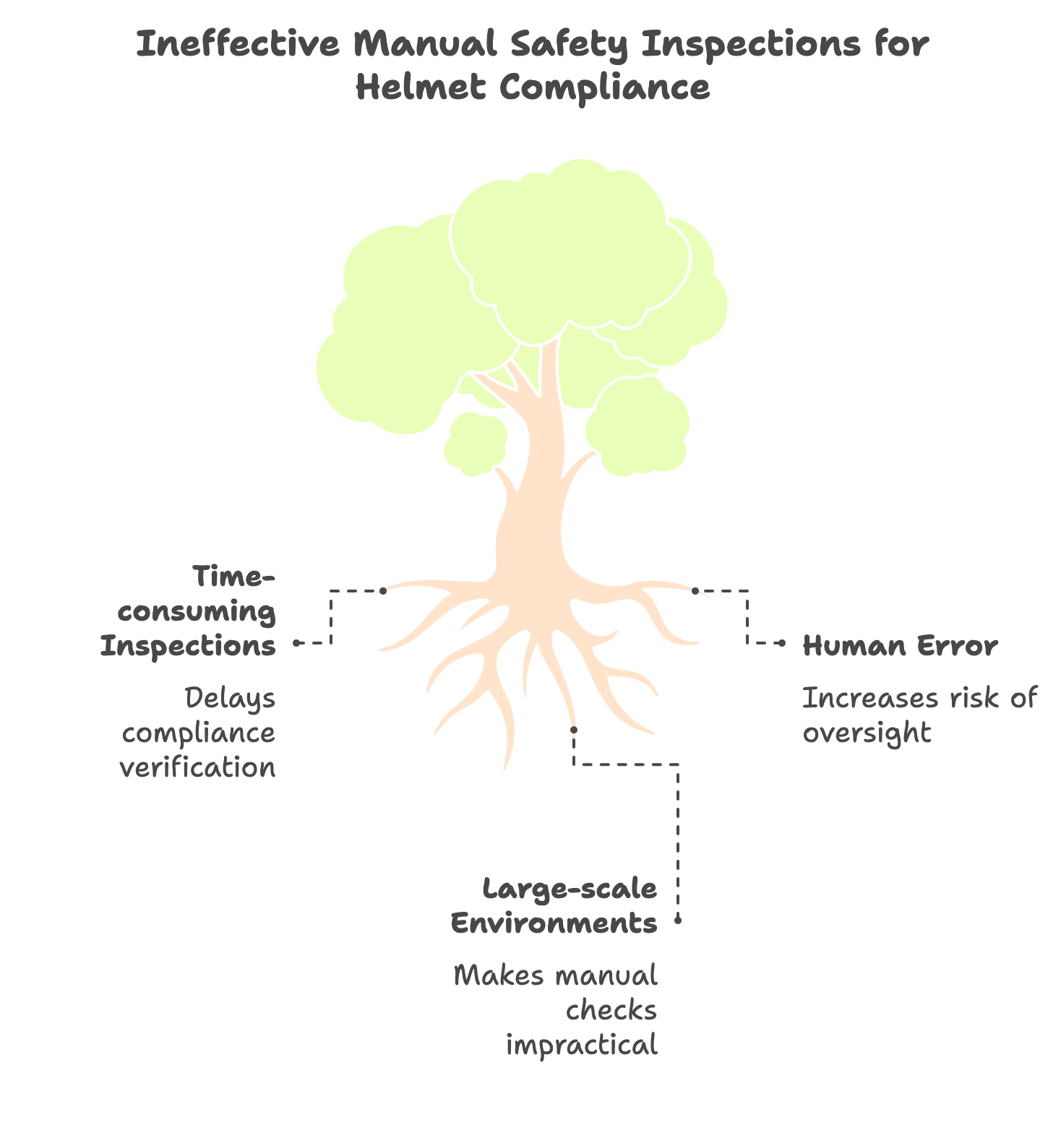
Problem Statement
Many industries (construction, mining, manufacturing, traffic) require mandatory helmet-wearing to protect workers from head injuries.
Manual safety inspections are time-consuming, prone to human error, and ineffective in large-scale environments.

Slide 3
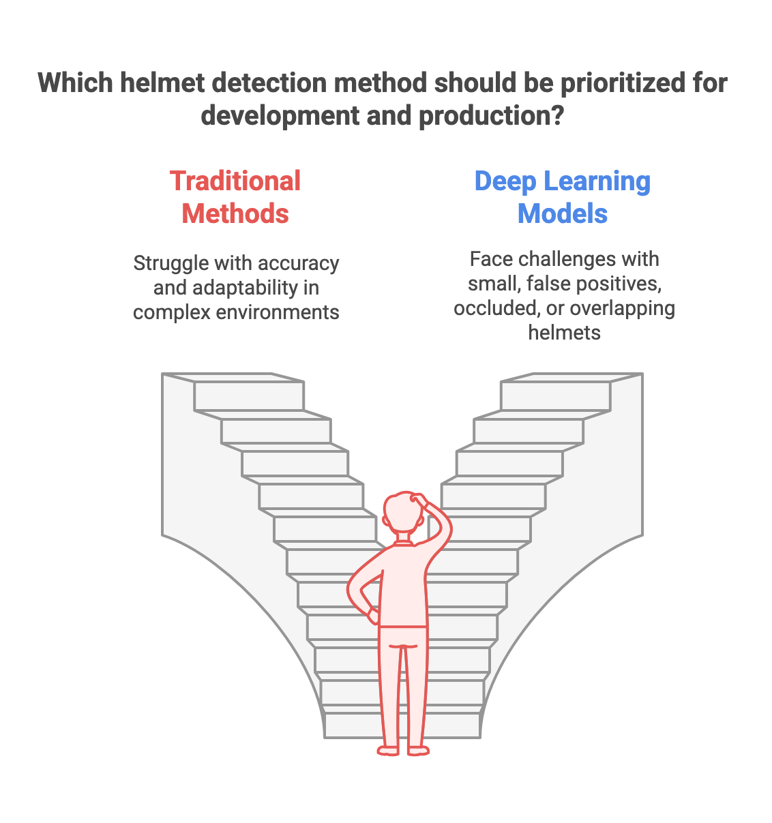
Limitations
Traditional methods (HOG, SVM, Haar cascades) struggle with accuracy and adaptability in complex environments.
Current deep learning models (YOLO, Faster R-CNN, SSD) face challenges in detecting small, false positives, occluded, or overlapping helmets.

Slide 4
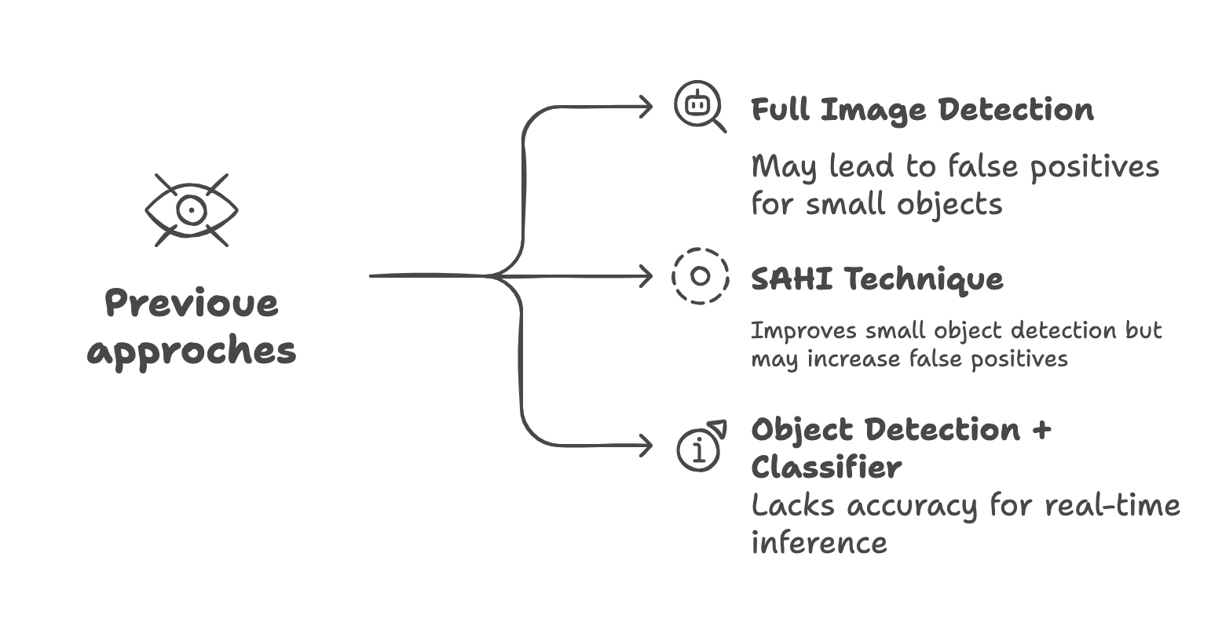
Most Common Technique and Research Gap
Detect object on full image
After systematic literature review we have come to know most of the cases researchers using object detection on full image which may cause false positives in case of small object
Using techniques like SAHI can detect small objects in image but cause false positives.
In previous techniques another problem is not real time inference.
In case of PPE we need real time inference.
In some papers researchers use object detection then use a classifier to classify if there is object or not but this is not accurate.

Slide 5
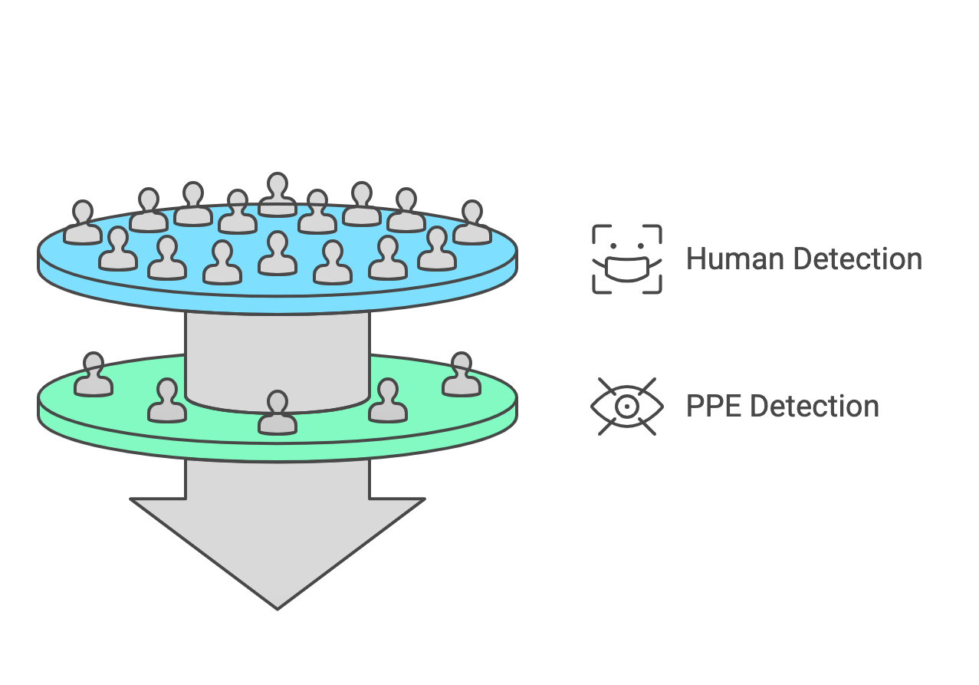
Proposed Solution/ Novelty
Reference Object Detection (Person Identification)
A YOLO model trained specifically to detect humans acts as the first filter.
This ensures that only regions containing a person are analyzed further, eliminating irrelevant detections.
PPE Detection (Helmet, Vest, Safety Goggles, etc.)
A secondary YOLO model, fine-tuned for PPE recognition, is applied exclusively within the detected human regions.
This stage prevents false detections on background objects, machinery, or random artifacts.

Slide 6
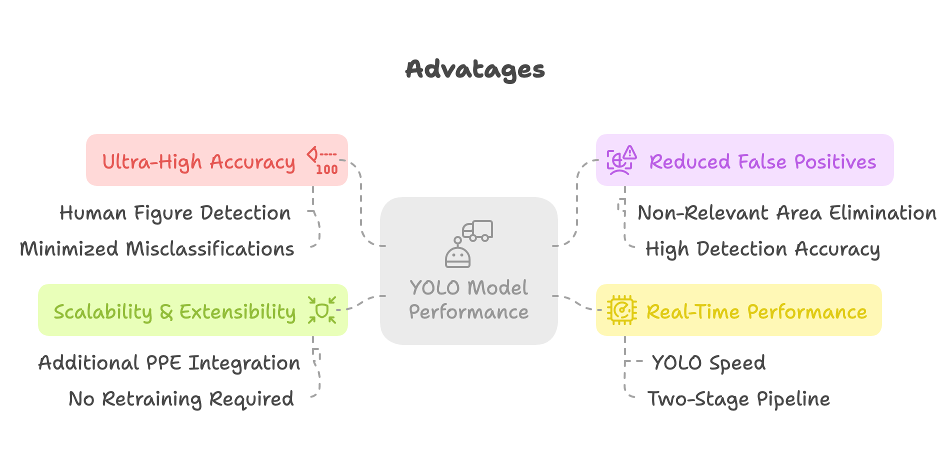
Advantages
Ultra-High Accuracy (>98%) – By constraining detection to human figures, the model drastically reduces misclassifications.
Drastically Reduced False Positives (1-2 per 100 detections) – Eliminating non-relevant areas minimizes the likelihood of incorrect classifications.
Real-Time Performance – YOLO’s inherent speed, combined with an efficient two-stage pipeline, ensures seamless execution in live environments.
Scalability & Extensibility – Additional PPE (such as vests and goggles) can be seamlessly integrated into the second detection layer without retraining the first model.

Slide 7
Thank you

